Slide 1
Energy Supplier | API Available
British Gas | Yes
EDF | No
Scottish Power | No
SSE | No
EON | No
OVO Energy | No
Octopus Energy | Yes

Slide 3
Name | Materials | Test Purpose
Prototype 1 | Wood | To test the flexibility of the wood material for the marble track
Prototype 2 | Wood, Acrylic | To test the look and feel of the acrylic material
Prototype 3 | Wood, Acrylic, Plastic | To test marble storage and test the feeding system
Prototype 4 | Wood, Acrylic, Plastic | To test a cover and controlling system

Slide 4
Company | Product | Website
E.ON Next | Smartview3 IHD, Smartview4 IHD | https://www.eonnext.com/help/ihd
Chameleon Technology | IHD3 and IHD7 | https://chameleontechnology.co.uk/
Eyedro | Eyedro Home Energy Monitor | https://eyedro.com/

Slide 5
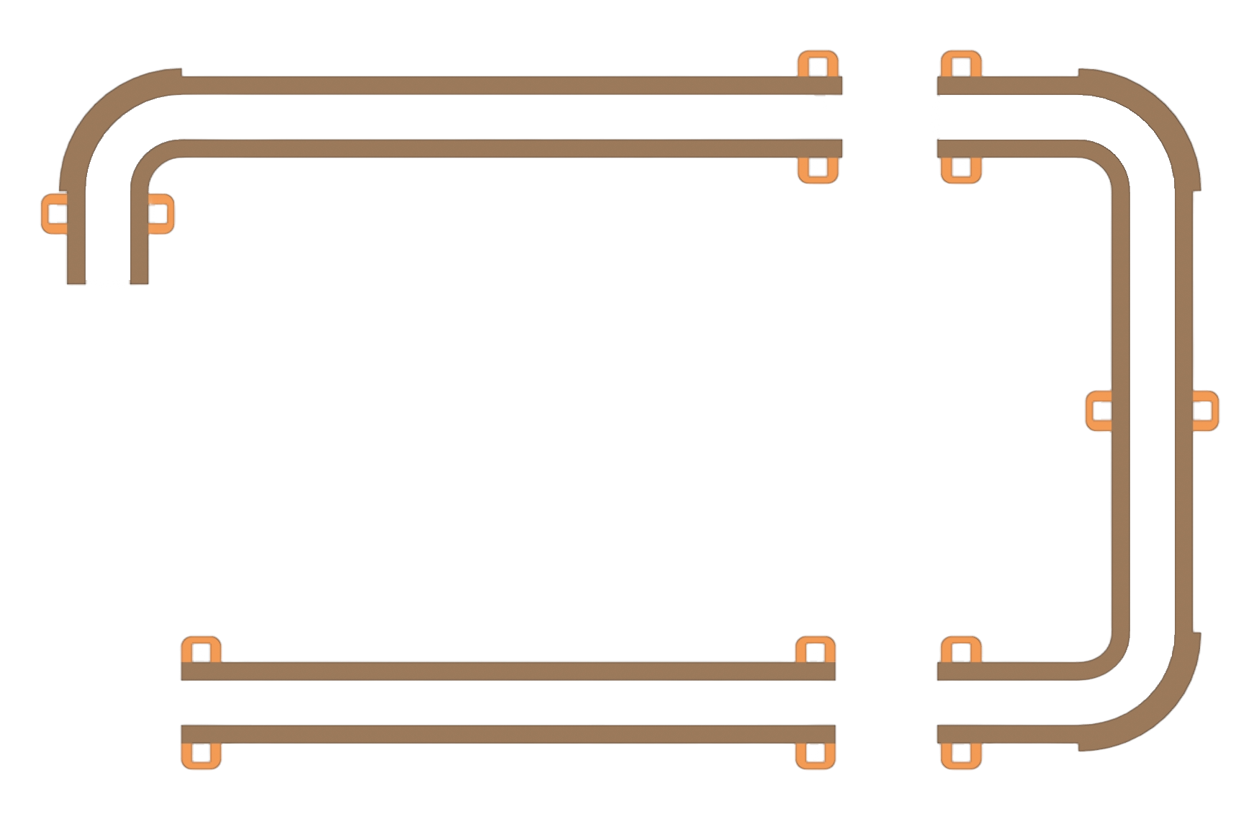
Bounce Guard
Type 1
Mounting Hook
Type 2
Type 3

Slide 6
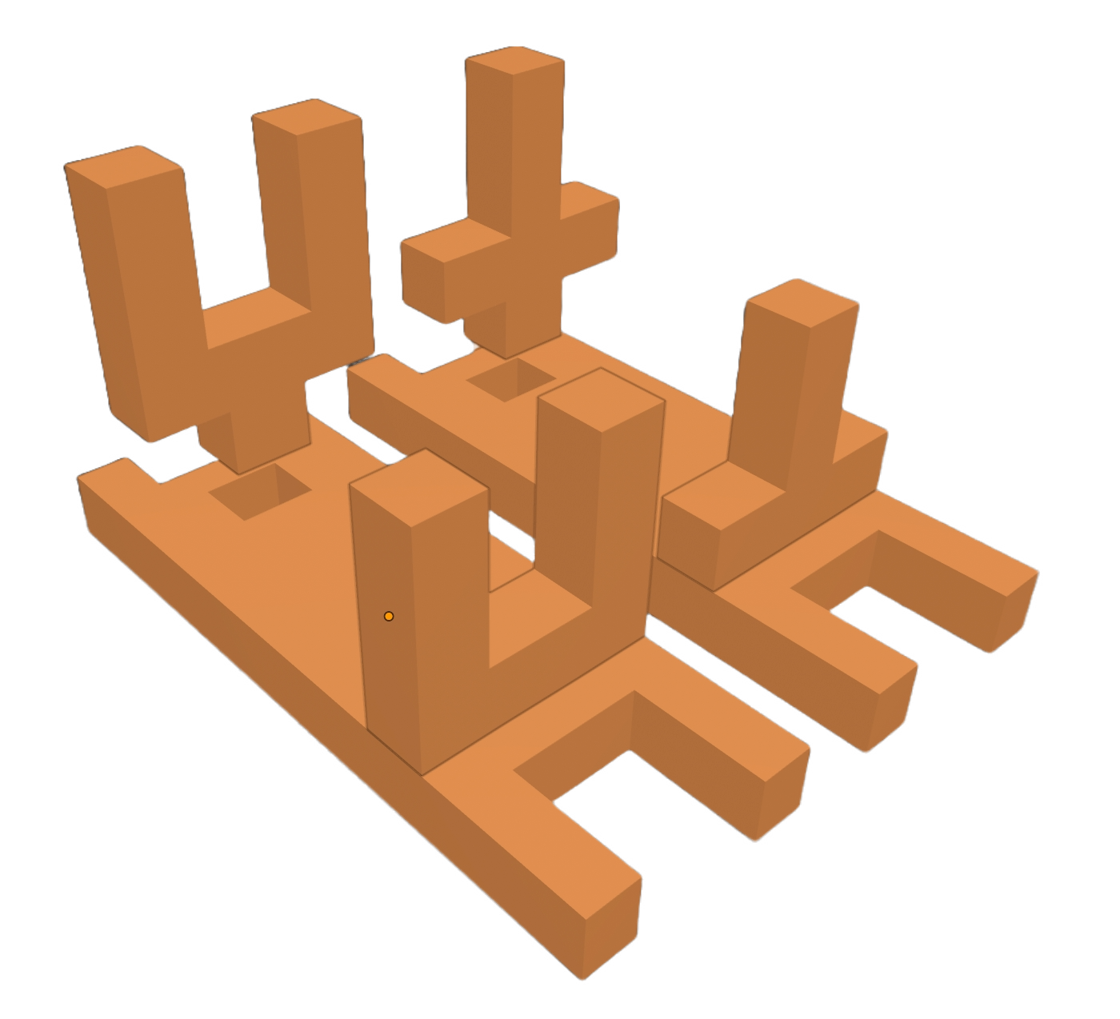
Mounting Column
Mounting Base

Slide 7
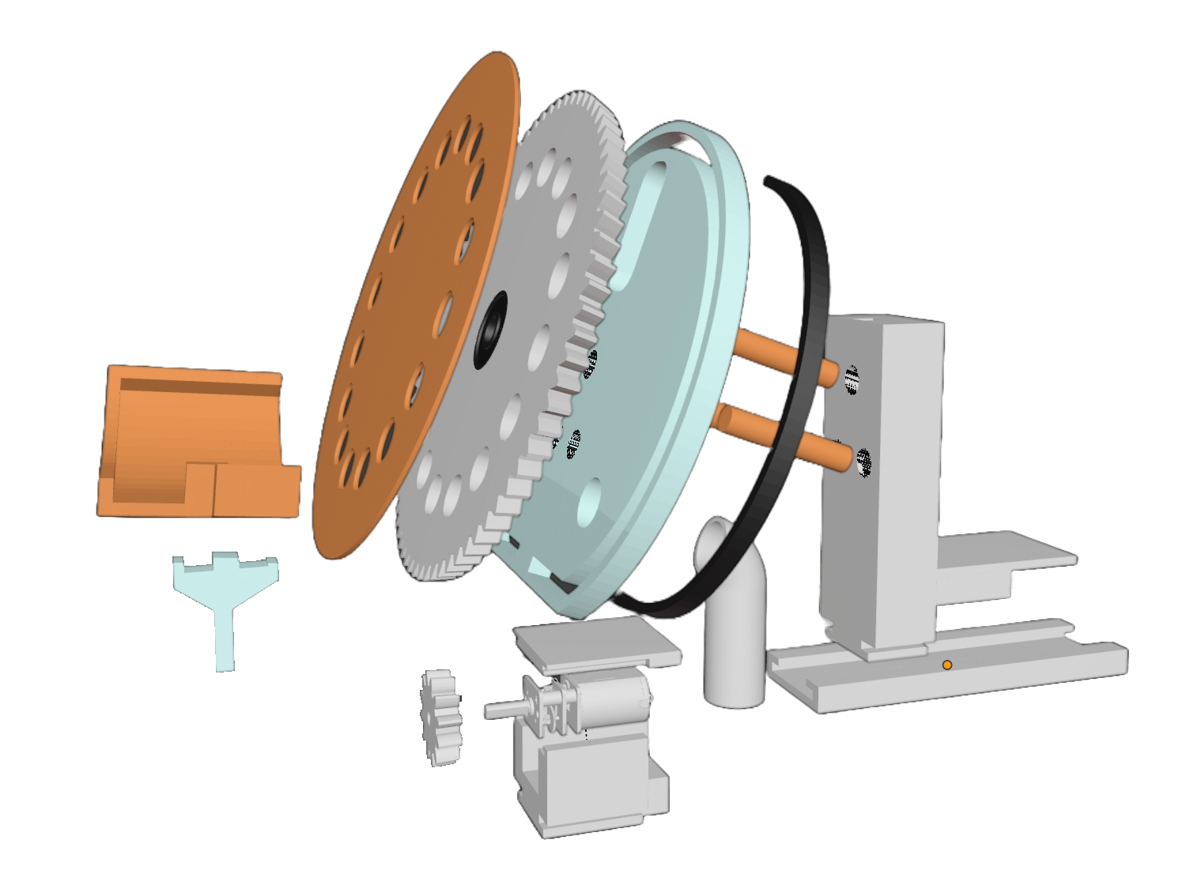
Main Cog
Back Board
Wheel Cover
LED Strip
Wheel Stand
Marble Platform
Platform Column
Rail
Sub Cog
Gearbox Motor
Marble Pipe
Motor Holder Top
Motor Holder Base

Slide 8
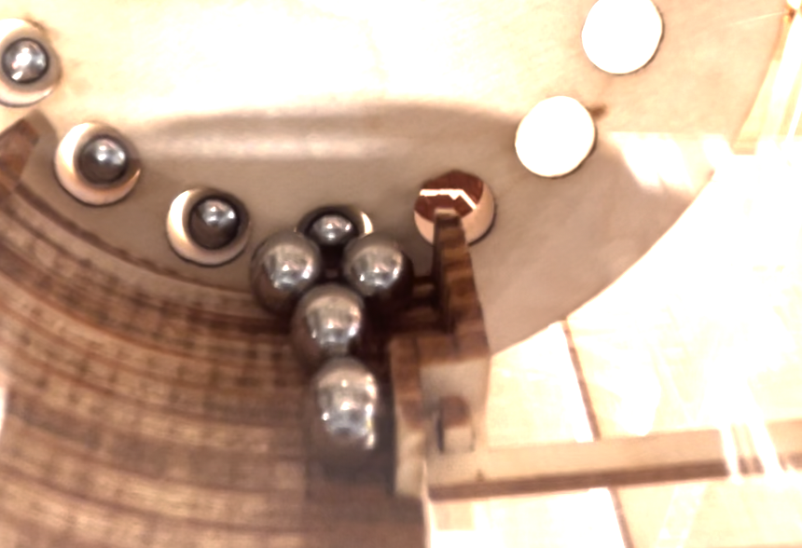
Copper Tape

Slide 9
Copper Tape
Marble
Marble
Signal
Ground
Signal
Ground
Back Board
Back Board
High
High
Low
Low

Slide 10
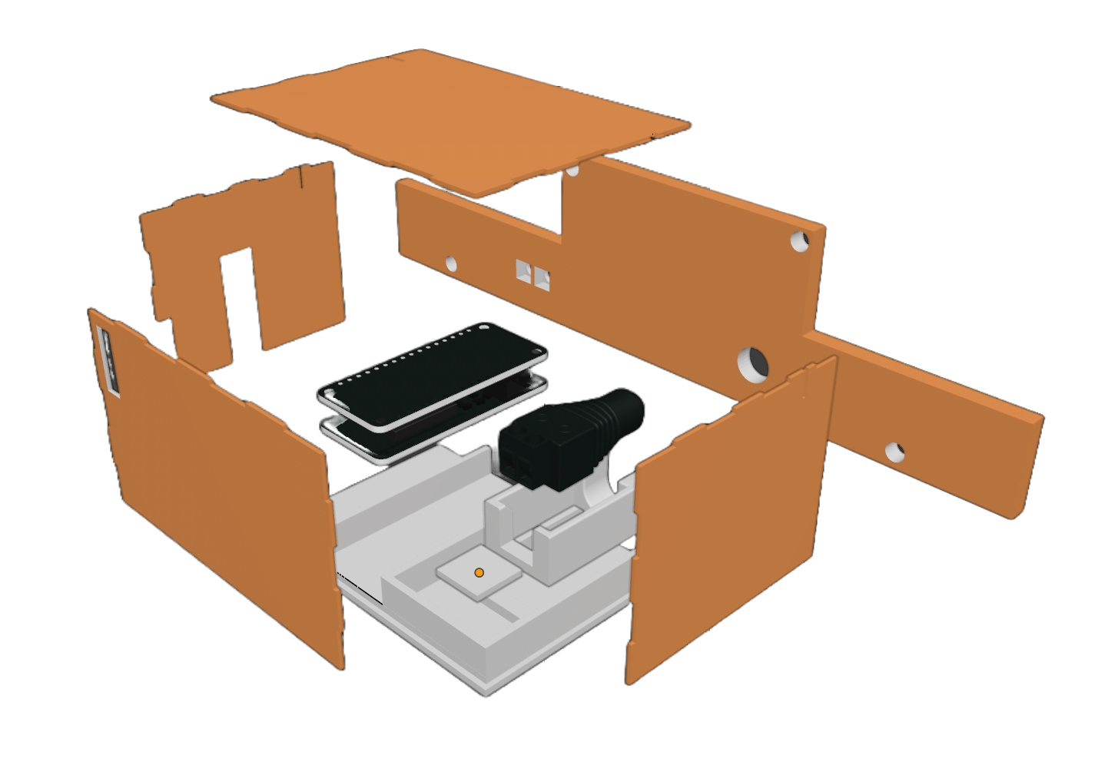
Top Cover
Power Jack
Microcontroller
with motor shield
Back Cover
Front Cover
Side Cover
Power Jack Base
Components Base

Slide 11
Model | CPU | Memory | Flash Memory | Price | Release Date
Arduino Uno | ATmega328P (8-bit) | 2 KB SRAM | 32 KB | $20 - $25 | 2010
Arduino Mega 2560 | ATmega2560 (8-bit) | 8 KB SRAM | 256 KB | $40 - $60 | 2010
ESP32 | Xtensa LX6 dual-core (32-bit) | 520 KB SRAM | Up to 16 MB | $5 - $10 | 2016
STM32F103 (Blue Pill) | ARM Cortex-M3 (32-bit) | 20 KB SRAM | 64 KB - 128 KB | $2 - $5 | 2007
Raspberry Pi 4B | Broadcom BCM2711, Quad-core Cortex-A72 (64-bit) | 2 GB - 8 GB DDR4 | No built-in flash (MicroSD card for storage) | $35 (2GB) - $75 (8GB) | 2019

Slide 12
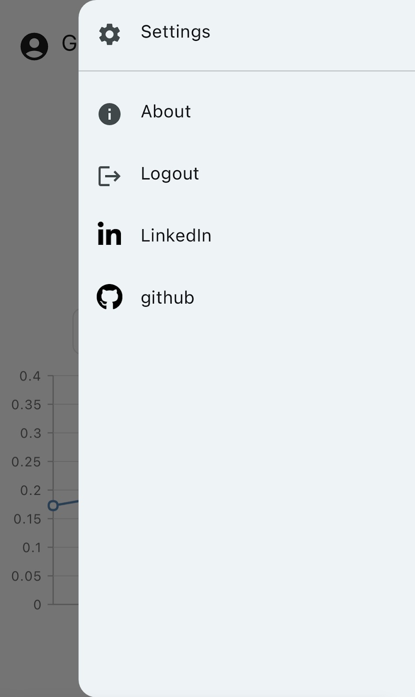
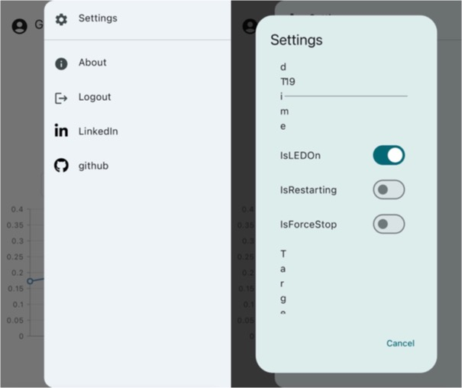
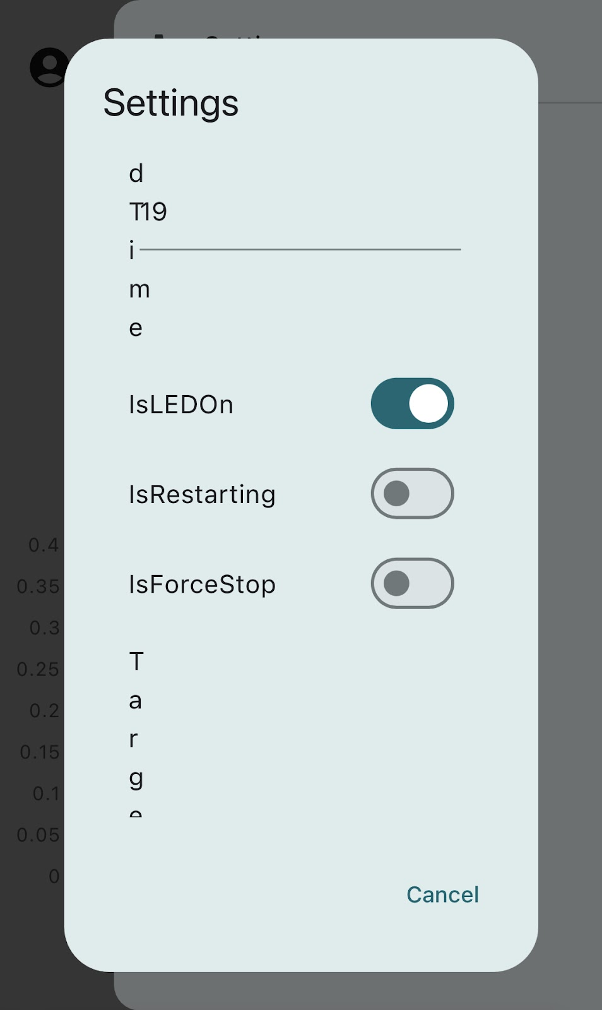

Slide 13
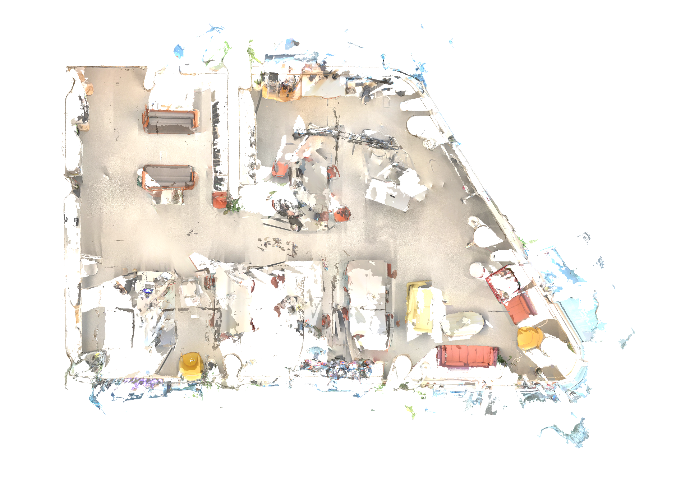
Soldering Station
Two TVs
Four 3D Printers

